Slide 1
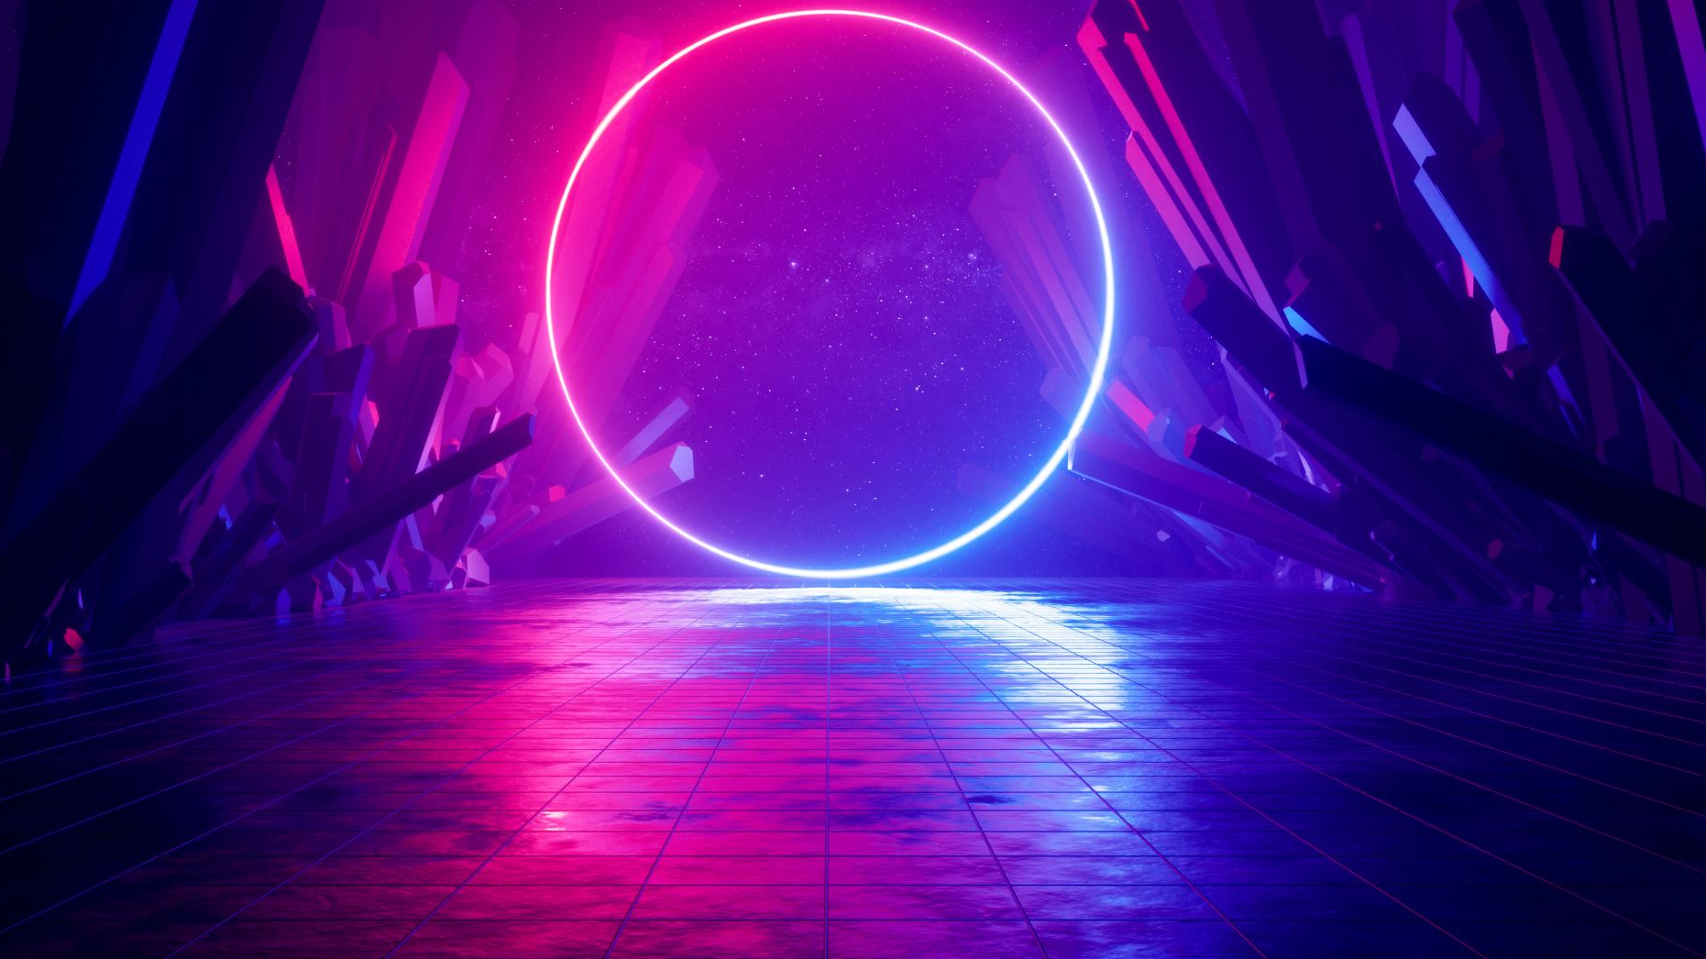
Bio-code the patenting website for bioinformaticians
E=b² -4ac
Like share & subscribe
Thanks for watching

Slide 2


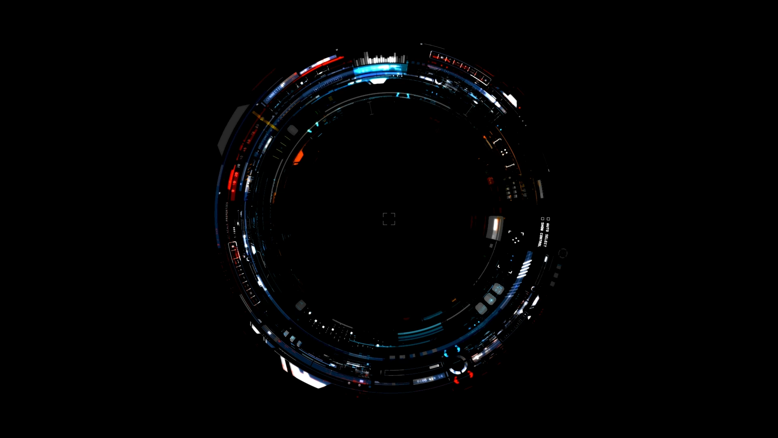
BIO-CODE
Intro
History of patents
Law & benefits
IPR deep dive
Code & output
Process of patenting
Indian patenting status
background research
Motivation
Tech used
Functions used
Challenges
Feature
Future
Bibliography
End page

Slide 3
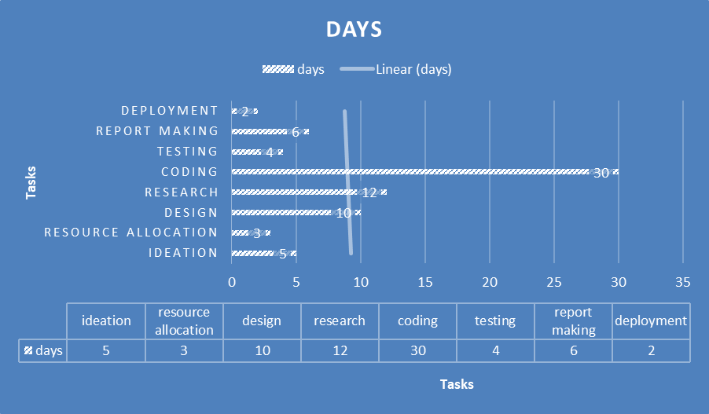
Choose option
Give python code for checking uniqueness
Else add user details for auth, if chose store or certify
Inspire from database if chosen inspire
Else add price range,if chose sell
Methodology
Agile Methodology is used as project involves developing a complex web application with features like code uniqueness checks evolve with changing requirements, file storage, and user authentication, iterative development, with features are built and tested in short cycles (sprints) allowing flexibility and adaptation to changing requirements, benefits from feedback, especially for usability and feature improvements, broken down into smaller, manageable features (e.g., user authentication, file upload, code uniqueness).
workflow
Roles-frontend,backend & database developer(spark,gson,html,java,JDBC,MYSQL,maven framework,CSS,JS & restful partial API),Microsoft powerpoint N word for presentation,report &abstract,tester,speaker-Mega RAHH
Project timeline
Objective & impact-our objective is to promote innovation culture & patent is only way to incentivize & secure your right of your creation.so,our efforts should boost research,collaboration(patent for improving project),keeping knowledge safe with rightful credit then mke it reach to every household,tapping every perspective of human potential
Literary survey-no online patent filing facility found only info Indian site found,all facilities like uniqueness check & inspire not provided in one place,no sale assistance,no form fillup assistance & kinda tiresome process,no legal help with customer support,not search engine optimized or marketed,highly fragmented industry without standardization
Success Measurement parameters-No. of registration,No. of successful patents filed,No. of active users,Performance & customer satisfaction

Slide 4

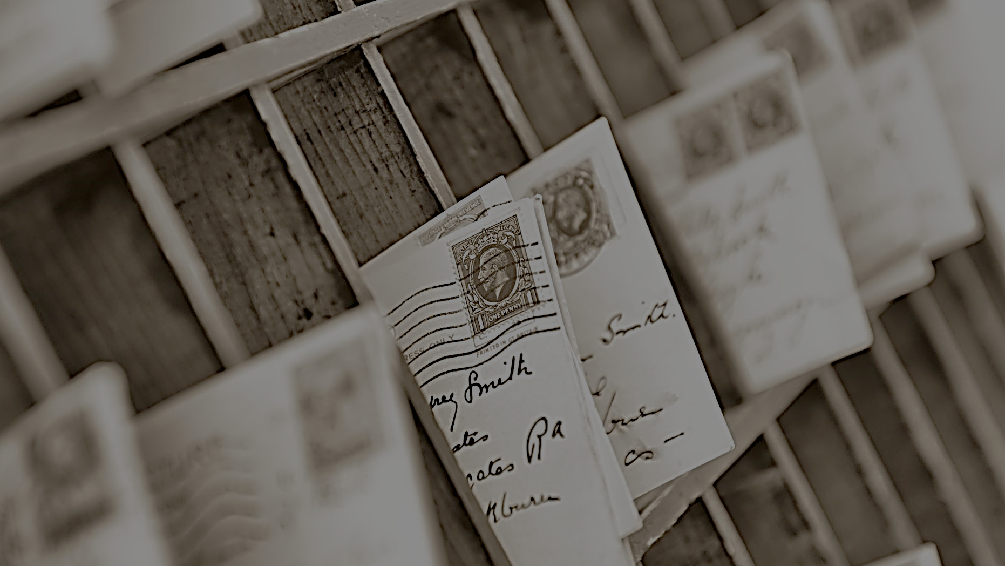

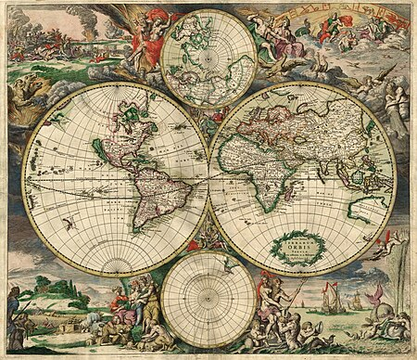
History of patenting
Pre-Digital Era Foundations:
19th Century:
Ada Lovelace's work on Charles Babbage's Analytical Engine lays the conceptual groundwork for computer programming. Though not law, it's the genesis of software ideas.
Early 20th Century:
The development of early computers like the Z series in Germany and the Atanasoff-Berry Computer in the U.S. begins the era of electronic computation. Legal issues are primarily related to hardware and industrial applications.
The Rise of Computing and Early Legal Responses:
1960s:
Early software begins to emerge as a distinct entity. Copyright discussions begin, but legal protections are unclear.
In bioinformatics, early databases like Margaret Dayhoff's protein sequence databases are developed, laying the foundation for computational biology.
1970s:
Copyright law begins to adapt to address software, with some jurisdictions recognizing copyright protection for computer programs.
DNA sequencing technologies advance, creating a surge in biological data and the need for computational analysis.
Landmark Cases and Legislation:
1980: Diamond v. Chakrabarty (U.S.):
The U.S. Supreme Court rules that genetically modified organisms are patentable, establishing a precedent for biotechnology patents and influencing later bioinformatics patenting.
1980s:
The personal computer revolution and the early internet raise concerns about software piracy and cybercrime.
The rise of commercial software leads to increased focus on software copyright and licensing.
1986: Computer Fraud and Abuse Act (CFAA) (U.S.):
This U.S. legislation criminalizes certain computer-related activities, marking a significant step in cyberlaw.
1990s:
The World Wide Web emerges, transforming communication and commerce and necessitating new legal frameworks for online activities.
The Human Genome Project accelerates the growth of bioinformatics and the need for computational tools.
Software patents become more common, but their validity is often debated.
The 21st Century: Internet, Data, and Bioinformatics:
2000: Information Technology Act (India):
Provides a legal framework for electronic transactions and cybercrime in India, reflecting the growing importance of cyberlaw in developing nations.
Early 2000s:
Debates intensify regarding the patentability of software and gene sequences, with concerns about stifling innovation.
Data privacy becomes a major concern, leading to the development of data protection laws.
2008: Information Technology (Amendment) Act (India):
Updates the Indian IT Act, addressing evolving cybersecurity threats and data protection concerns.
2010s:
"Big Data" in biology and the rise of artificial intelligence present new challenges for patent law, data protection, and ethical considerations.
The U.S. Supreme Court decisions like Mayo Collaborative Services v. Prometheus Laboratories, Inc. (2012) and Association for Molecular Pathology v. Myriad Genetics, Inc. ¹ (2013) significantly impact the patentability of natural phenomena and isolated DNA sequences, affecting bioinformatics patenting.
The patentability of software becomes even more scrutinized.
2018: General Data Protection Regulation (GDPR) (EU):
Sets a new global standard for data privacy, impacting organizations worldwide and influencing data protection laws in other jurisdictions.
Present:
Ongoing debates about AI ethics, data ownership, and the patenting of bioinformatics algorithms and software.
Continuous evolution of cybersecurity laws to address emerging threats like ransomware and sophisticated cyberattacks.
Increased focus on open source software and open data within the bioinformatics community.
Bioinformatics Patenting Specifics:
Early patents focused on gene sequences and diagnostic methods.
Later patents shifted towards bioinformatics tools, algorithms, and databases.
Current trends involve patents on personalized medicine, drug discovery, and AI-driven bioinformatics applications.
Ethical concerns about gene patents and data ownership remain significant.
This Photo by Unknown Author is licensed under CC BY-SA

Slide 5
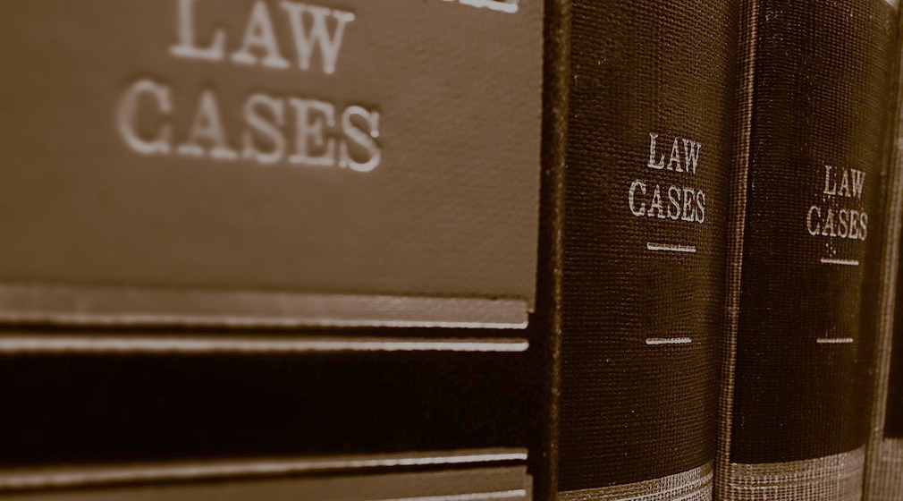
Laws is “lag” in latin means fixed,definite,followed,stable,uniform & regulated are rules for behaviour at time of action & rectifying unlawful action regulate activities & prevents & unjust & abusive practices that brings chaos & anarchy which behaviour hinders progress & reduces quality of life,raising communities by allotting consequences proportional to the crime,strengthening democracy but can be amended for benefit of people by legislatures & councils at state & parliament at centre,bill introduced & originated from lok sabha passes after three readings to rajya sabha for debate & vote where it gets rejected,accepted or amended,if amended returns in amended form becomes act then passed to president with his assent becomes law which may be revised when unfair or harmfuk & unacceptable to large mass of people creating conflicts & tensions gets criticised on tv,protests,meetings & newspapers are called controversial laws.
Notes:
Eg of need for law-abolishment of untouchability is good as it gave life of dignity & self respect to oppressed & encourage them to participate in progress better tapping into human resource potential
Eg of amendment & role of citizens in law-Protection of women from domestic violence act in 2006 led to enactment by voices raised against domestic violence by social groups,women orgs & feminists at the time

Slide 6

Dive deep in IPR!
Information or acquired knowledge is intellectual capital of an entity gets ethical issues by usage or availability of information which are:Intellectual property:a piece of information created requires time,money & efforts but becomes easy duplication & sharing after content produced which makes it difficult to safeguard ,so, every owner has right to protect intellectual property & decide how much info gets exchanged,distributed or shared & decide its pricing,done by copyright-a legal term describing the rights of creator for his literary works or softwares protecting authorship work like book,motion pictures,sound etc till 60 years more than author’s life but work must be original,creative & in a fixed tangible medium,controlling reproduction,making derivative,distribution,public performance or display of copyrighted works patents-collection of exclusive rights for inventors for their inventions such as processes,machine,manufactures,matter composition or their improvement which should be new,useful & non-obvious for 20 years prevent others from selling,using or importing the invention trademarks-registered words,slogans,logos,shape,colour & sounds distinguishing products of one trader from other act as symbol of identification which should be distinctive stays as long as mark used in commerce prevents others using mark when it causes likelihood-of-confusion about origin of products. These laws encourage new invention or improving existing ones,ensures new idea’s distribution,promotes investment in economy

Slide 7
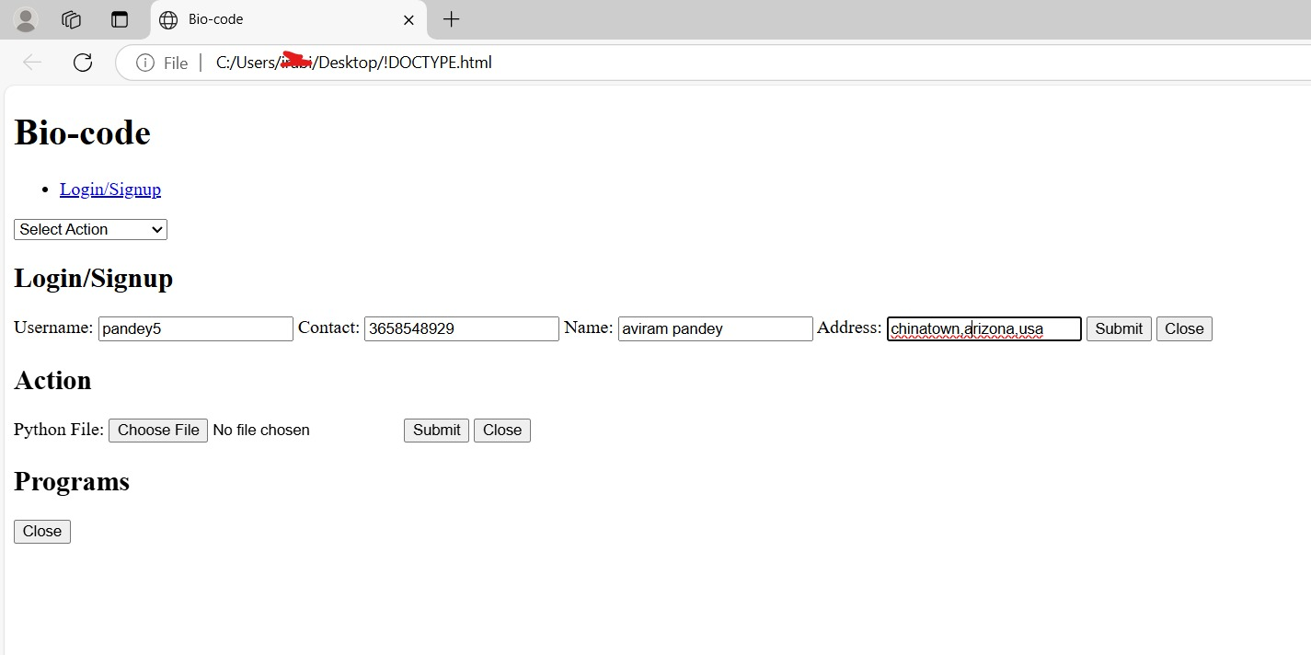

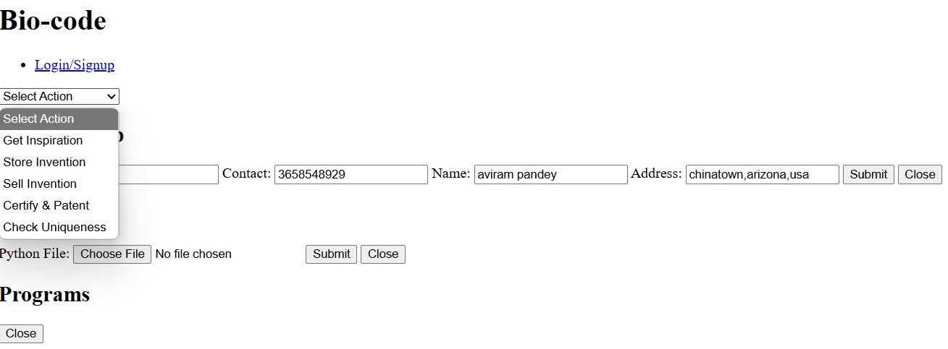
Code n output
Sql-
CREATE DATABASE IF NOT EXISTS biocode;
USE biocode;
CREATE TABLE IF NOT EXISTS users ( id INT AUTO_INCREMENT PRIMARY KEY, username VARCHAR(255) UNIQUE NOT NULL, contact VARCHAR(255) NOT NULL, name VARCHAR(255) NOT NULL, address VARCHAR(255) NOT NULL);CREATE TABLE IF NOT EXISTS inventions ( id INT AUTO_INCREMENT PRIMARY KEY, userId INT, inventionName VARCHAR(255) NOT NULL, filePath VARCHAR(255), price DECIMAL(10, 2), isCertified BOOLEAN DEFAULT FALSE, FOREIGN KEY (userId) REFERENCES users(id));

Slide 8
Part-2
import com.google.gson.Gson;
import com.google.gson.JsonObject;
import spark.Spark;
import java.sql.*;
import java.nio.file.*;
import java.io.InputStream;
import java.util.Map;
import java.util.Random;
public class BicodeBackend {
private static final String JDBC_URL = "jdbc:mysql://localhost:3306/bicode";
private static final String JDBC_USER = "your_mysql_username"; // Replace with your MySQL username
private static final String JDBC_PASSWORD = "your_mysql_password"; // Replace with your MySQL password
private static final String UPLOAD_DIR = "uploads/";
public static void main(String[] args) {
Spark.port(4567);
Path uploadPath = Paths.get(UPLOAD_DIR);
if (!Files.exists(uploadPath)) {
try {
Files.createDirectories(uploadPath);
} catch (Exception e) {
e.printStackTrace();
}
}
Spark.post("/login", (request, response) -> {
response.type("application/json");
String username = request.queryParams("username");
String contact = request.queryParams("contact");
String name = request.queryParams("name");
String address = request.queryParams("address");
try (Connection conn = DriverManager.getConnection(JDBC_URL, JDBC_USER, JDBC_PASSWORD)) {
PreparedStatement checkStmt = conn.prepareStatement("SELECT id FROM users WHERE username = ?");
checkStmt.setString(1, username);
ResultSet rs = checkStmt.executeQuery();
}
}
if (rs.next()) {
PreparedStatement stmt = conn.prepareStatement("SELECT id FROM users WHERE username = ? AND contact = ?");
stmt.setString(1, username);
stmt.setString(2, contact);
ResultSet rs2 = stmt.executeQuery();
if(rs2.next()){
JsonObject jsonResponse = new JsonObject();
jsonResponse.addProperty("success", true);
JsonObject userJson = new JsonObject();
userJson.addProperty("id", rs2.getInt("id"));
userJson.addProperty("username", username);
userJson.addProperty("contact", contact);
jsonResponse.add("user", userJson);
return jsonResponse.toString();
}else{
return new Gson().toJson(Map.of("success", false, "message", "Invalid credentials"));
}
} else {
PreparedStatement insertStmt = conn.prepareStatement("INSERT INTO users (username, contact, name, address) VALUES (?, ?, ?, ?)", Statement.RETURN_GENERATED_KEYS);
insertStmt.setString(1, username);
insertStmt.setString(2, contact);
insertStmt.setString(3, name);
insertStmt.setString(4, address);
insertStmt.executeUpdate();
ResultSet generatedKeys = insertStmt.getGeneratedKeys();
if (generatedKeys.next()) {
JsonObject jsonResponse = new JsonObject();
jsonResponse.addProperty("success", true);
JsonObject userJson = new JsonObject();
userJson.addProperty("id", generatedKeys.getInt(1));
userJson.addProperty("username", username);
userJson.addProperty("contact", contact);
jsonResponse.add("user", userJson);
return jsonResponse.toString();
} else {
return new Gson().toJson(Map.of("success", false, "message", "Signup failed."));
}
}
} catch (SQLException e) {
e.printStackTrace();
return new Gson().toJson(Map.of("success", false, "message", "Database error"));
}
});
Spark.get("/inspiration", (request, response) -> {

Slide 9
response.type("application/json"); String[] topics = {"Machine Learning for Drug Discovery", "AI in Genomics", "Bioinformatics for Personalized Medicine", "Computational Biology for Disease Modeling", "Data Analysis in Ecology"}; Random rand = new Random(); int randomIndex = rand.nextInt(topics.length); return new Gson().toJson(Map.of("topic", topics[randomIndex])); }); Spark.post("/store", (request, response) -> { response.type("application/json"); int userId = Integer.parseInt(request.queryParams("userId")); try (InputStream is = request.raw().getPart("pythonFile").getInputStream(); Connection conn = DriverManager.getConnection(JDBC_URL, JDBC_USER, JDBC_PASSWORD); PreparedStatement stmt = conn.prepareStatement("INSERT INTO inventions (userId, inventionName, filePath) VALUES (?, ?, ?)")) { String fileName = System.currentTimeMillis() + "_" + request.raw().getPart("pythonFile").getSubmittedFileName(); String filePath = UPLOAD_DIR + fileName; Files.copy(is, Paths.get(filePath), StandardCopyOption.REPLACE_EXISTING); stmt.setInt(1, userId); stmt.setString(2, request.raw().getPart("pythonFile").getSubmittedFileName()); stmt.setString(3, filePath); stmt.executeUpdate(); return new Gson().toJson(Map.of("success", true, "message", "Invention stored successfully.")); } catch (Exception e) { e.printStackTrace(); return new Gson().toJson(Map.of("success", false, "message", "Storage failed: " + e.getMessage())); } }); Spark.post("/sell", (request, response) -> { response.type("application/json"); int userId = Integer.parseInt(request.queryParams("userId")); double price = Double.parseDouble(request.queryParams("price")); try (InputStream is = request.raw().getPart("pythonFile").getInputStream(); Connection conn = DriverManager.getConnection(JDBC_URL, JDBC_USER, JDBC_PASSWORD); PreparedStatement stmt = conn.prepareStatement("INSERT INTO inventions (userId, inventionName, filePath, price) VALUES (?, ?, ?, ?)")) { String fileName = System.currentTimeMillis() + "_" + request.raw().getPart("pythonFile").getSubmittedFileName(); String filePath = UPLOAD_DIR + fileName; Files.copy(is, Paths.get(filePath), StandardCopyOption.REPLACE_EXISTING); stmt.setInt(1, userId); stmt.setString(2, request.raw().getPart("pythonFile").getSubmittedFileName()); stmt.setString(3, filePath); stmt.setDouble(4, price); stmt.executeUpdate(); return new Gson().toJson(Map.of("success", true, "message", "Invention listed for sale.")); } catch (Exception e) { e.printStackTrace(); return new Gson().toJson(Map.of("success", false, "message", "Sale listing failed: " + e.getMessage())); } });
Spark.post("/certify", (request, response) -> { response.type("application/json"); int userId = Integer.parseInt(request.queryParams("userId")); try (InputStream is = request.raw().getPart("pythonFile").getInputStream(); Connection conn = DriverManager.getConnection(JDBC_URL, JDBC_USER, JDBC_PASSWORD); PreparedStatement stmt = conn.prepareStatement("INSERT INTO inventions (userId, inventionName, filePath, isCertified) VALUES (?, ?, ?, ?)")) { String fileName = System.currentTimeMillis() + "_" + request.raw().getPart("pythonFile").getSubmittedFileName(); String filePath = UPLOAD_DIR + fileName; Files.copy(is, Paths.get(filePath), StandardCopyOption.REPLACE_EXISTING); stmt.setInt(1, userId); stmt.setString(2, request.raw().getPart("pythonFile").getSubmittedFileName()); stmt.setString(3, filePath); stmt.setBoolean(4, true); stmt.executeUpdate(); return new Gson().toJson(Map.of("success", true, "message", "Invention certified and patented.")); } catch (Exception e) { e.printStackTrace(); return new Gson().toJson(Map.of("success", false, "message", "Certification failed: " + e.getMessage())); } }); Spark.post("/check", (request, response) -> { response.type("application/json"); // Implement uniqueness check logic here return new Gson().toJson(Map.of("success", true, "message", "Uniqueness checked.")); });

Slide 10
<form id="action-submit-form" enctype="multipart/form-data">
<label for="pythonFile">Python File:</label>
<input type="file" id="pythonFile" name="pythonFile" accept=".py" required>
<textarea id="programCode" name="programCode" style="display:none;"></textarea>
<button type="submit">Submit</button>
<button type="button" class="close-button">Close</button>
</form>
</div>
<div id="programs-view" class="modal">
<h2>Programs</h2>
<div id="program-list"></div>
<button type="button" class="close-button">Close</button>
</div>
<div id="overlay" class="overlay"></div>
<script>
document.addEventListener('DOMContentLoaded', () => {
const loginLink = document.getElementById('login-link');
const loginForm = document.getElementById('login-form');
const userActions = document.getElementById('user-actions');
const actionSelect = document.getElementById('action-select');
const actionForm = document.getElementById('action-form');
const actionSubmitForm = document.getElementById('action-submit-form');
const overlay = document.getElementById('overlay');
const closeButtons = document.querySelectorAll('.close-button');
const programCodeField = document.getElementById('programCode');
let loggedInUser = null;
let currentAction = ‘’;
function showModal(modal) {
modal.style.display = 'block';
overlay.style.display = 'block';
}
function hideModal(modal) {
modal.style.display = 'none';
overlay.style.display = 'none';
}
loginLink.addEventListener('click', () => showModal(loginForm));
closeButtons.forEach(button => {
button.addEventListener('click', () => {
const modal = button.closest('.modal');
hideModal(modal);
});
});
overlay.addEventListener('click', () => {
document.querySelectorAll('.modal').forEach(modal =>
hideModal(modal));
});
document.getElementById('user-form').addEventListener('submit', (event) => {
event.preventDefault();
const formData = new FormData(event.target);
fetch('/login', { method: 'POST', body: formData })
.then(response => response.json())
.then(data => {
console.log("Login Response:", data);
if (data.success) {
loggedInUser = data.user;
userActions.style.display = 'inline';
loginLink.style.display = 'none';
hideModal(loginForm);
} else {
alert(data.message);
}
})
.catch(error => console.error('Login Error:', error));
});
actionSelect.addEventListener('change', () => {
currentAction = actionSelect.value;
if (currentAction) {
if (currentAction === 'check') {
programCodeField.style.display = 'block';
} else {
programCodeField.style.display = 'none';
}
showModal(actionForm);
}
});
actionSubmitForm.addEventListener('submit', (event) => {
event.preventDefault();
const formData = new FormData(event.target);
let url = '';
if (currentAction === 'store’)
{
url = '/store';
formData.append("userId", loggedInUser.id);
} else if (currentAction === 'check') {
url = '/check';
formData.append("programCode", programCodeField.value);
} else if (currentAction === 'inspiration') {
url = '/inspiration';
fetch(url)
.then(response => response.json())
then(data => alert("Topic: " +
. data.topic))
.catch(error => console.error('Inspiration Error:', error));
hideModal(actionForm);
return;
} else if (currentAction === 'certify') {
url = '/certify';
formData.append("userId", loggedInUser.id);
} else if (currentAction === 'sell') {
url = '/sell';
formData.append("userId", loggedInUser.id);
const price = prompt("Enter price:");
if (price) {
formData.append("price", price);
} else {
alert("Price is required.");
return;
}
}
if (url) {
fetch(url, { method: 'POST', body: formData })
.then(response => response.json())
.then(data => {
console.log("Action Response:", data);
alert(data.message);
})
.catch(error => console.error('Action Error:', error));
hideModal(actionForm);
}
});
});
</script>
</body>
</html>
<!DOCTYPE html>
<html lang="en">
<head>
<meta charset="UTF-8">
<meta name="viewport" content="width=device-width, initial-scale=1.0">
<title>Bio-code</title>
<style>
</style>
</head>
<body>
<header>
<h1>Bio-code</h1>
<nav>
<ul>
<li><a href="#" id="login-link">Login/Signup</a></li>
</ul>
</nav>
</header>
<main>
<section id="content">
<div id="user-actions">
<select id="action-select">
<option value="">Select Action</option>
<option value="inspiration">Get Inspiration</option>
<option value="store">Store Invention</option>
<option value="sell">Sell Invention</option>
<option value="certify">Certify & Patent</option>
<option value="check">Check Uniqueness</option>
</select>
</div>
</section>
</main>
<div id="login-form" class="modal">
<h2>Login/Signup</h2>
<form id="user-form">
<label for="username">Username:</label>
<input type="text" id="username" name="username" required>
<label for="contact">Contact:</label>
<input type="text" id="contact" name="contact" required>
<label for="name">Name:</label>
<input type="text" id="name" name="name" required>
<label for="address">Address:</label>
<input type="text" id="address" name="address" required>
<button type="submit">Submit</button>
<button type="button" class="close-button">Close</button>
</form>
</div>
<div id="action-form" class="modal">
<h2>Action</h2>

Slide 11

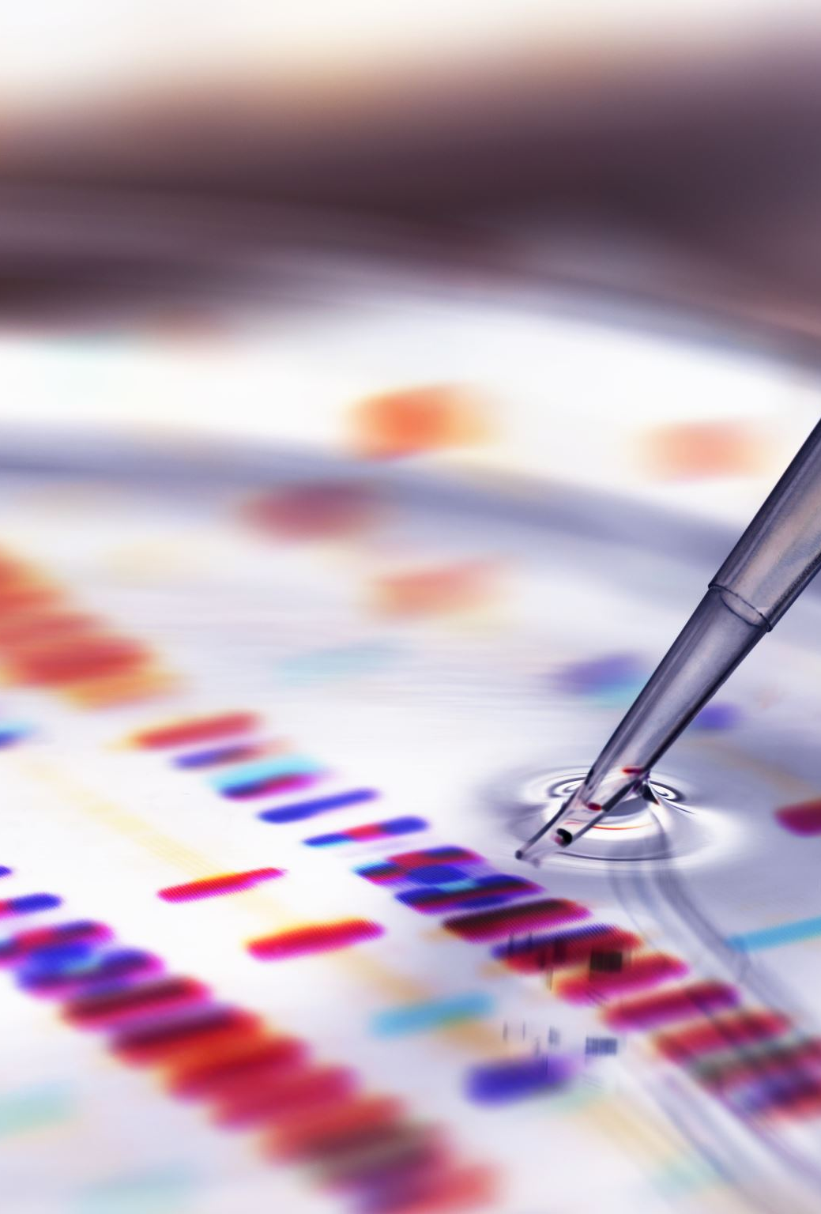
Patenting processes n content of form
Patent Process:
Invention Disclosure:the inventor documents their invention in detail, including its purpose, function, and how it works.
Patentability Search:A search is conducted to determine if the invention is novel and non-obvious from existing patents and publications (prior art).
Patent Application Preparation:
The inventor or a patent attorney prepares a patent application.
The application includes:
Specification: A detailed description of the invention.
Claims: Definitions of the scope of the invention's protection.
Drawings (if applicable): Visual representations of the invention.
Abstract: A brief summary of the invention.
Patent Application Filing:The patent application is filed with the appropriate patent office (e.g., the United States Patent and Trademark Office - USPTO, the European Patent Office - EPO) paying Filing fees.
Patent Examination:A patent examiner reviews the application to determine if it meets the patentability requirements then issue office actions, which are rejections or requests for clarification.which are responded by inventor or their attorney
Patent Grant:If the application is approved, the patent is granted.
Patent Maintenance:Patent holders must pay maintenance fees to keep their patents in force.

Slide 12
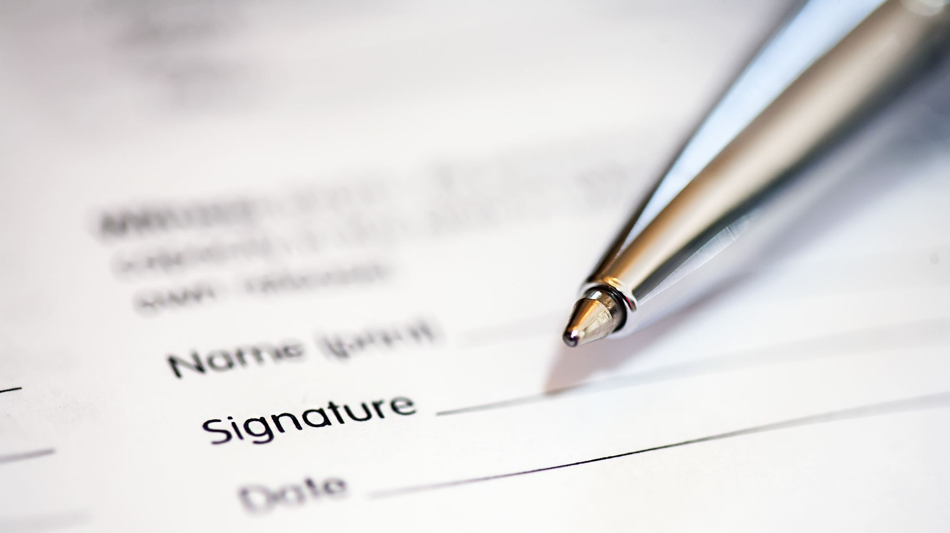
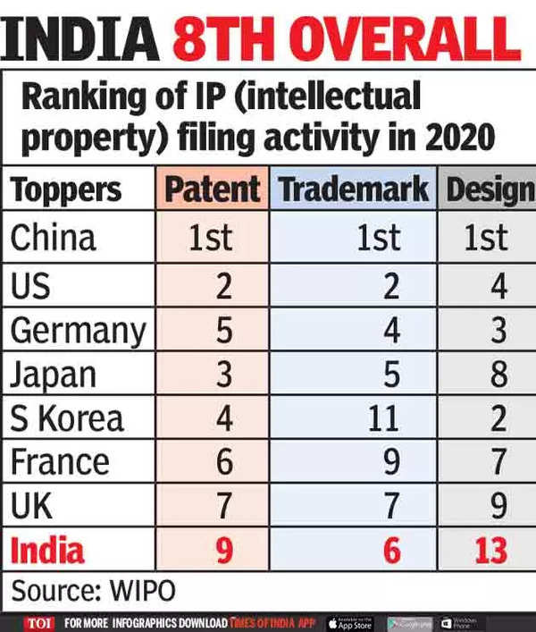
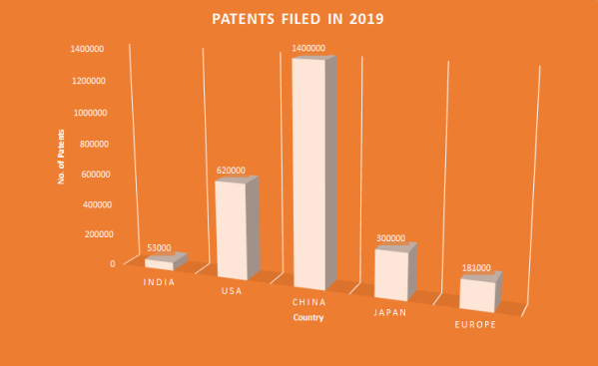
Patenting Quality vs Quantity in india
Challenges:
Insufficient Funding: R&D spending is low, limiting resources for innovation.
Infrastructure Limitations: Outdated facilities hinder cutting-edge research.
Skills Gap: Education lacks focus on critical thinking, causing a shortage of skilled researchers.
Bureaucratic Hurdles: Complex patent processes and regulations slow down innovation.
Limited Industry-Academia Collaboration: Research and industry needs are often disconnected.
Weak Intellectual Property Protection: Enforcement concerns discourage innovation and investment.
Potential Solutions:
Increased R&D Investment: Boost funding from government and private sectors.
Strengthening Infrastructure: Upgrade research facilities and establish centers of excellence.
Improving Education and Skill Development: Reform education to foster critical thinking and STEM skills.
Streamlining Patent Processes: Simplify and expedite patent applications and strengthen IP laws.
Fostering Industry-Academia Collaboration: Promote partnerships for collaborative research and technology transfer.
Promoting a Culture of Innovation: Encourage entrepreneurship and raise awareness of IP importance.(This is our goal)

Slide 13

intro
Biopatent-right granted by government to inventors giving control over their biological inventions given for:1.strains of microbes,2.cell lines,3.genetically modified strains of plants & animals,4.DNA sequences,5.Proteins encoded my DNA,6.various biotech process,7.production process,8.products & 9.product applications.with political & ethical objections & disqualified when its natural public knowledge. E.g.-1998 patent cancellations for healing of turmeric as it is an integral part of Indian culture,it raises a question that patent system promotes monopoly of private players,reducing sharing of knowledge due to fear of losing patent & restricting others research in that field but the only argument for this is boosting research & economy as it is a direct incentive to researcher also knowledge itself is valuable even without patentability,atleast in this case they will give documented records of research to someone for securing patents even many areas cant be claimed for patent like discovery of a new species as they’re not an invention but when these bio-resources are used by other organisation without authorisation from concerned country or people without compensatory payment.E.g.-Voyage beagle collection of resources from Galapagos island by Darwin
Exploitation of bioresources triggered clearance of second amendment of Indian patent bill which takes such issues into consideration with emergency provisions & research & development initiative
Bioethics to keep in mind while research:introduction of transgene from one species to other violates “integrity of species” or transfer of human gene in animals dilutes concept of ‘humanness’,biotech may pose unforeseen risks to environment & biodiversity by causing suffering to animals just for benefits,using their proteins for pharmacy like a ‘factory’
Ipr are rights related to restriction of commercial use of literary works,inventions and discoveries with no the permission of author,in computer industry its affected by:Patent,Contract,Undisclosed information &
Copyright- © is legal right for a statutorily determined term,once expired,becomes free for public use granted to creator of work to be sole user & distributer of it ,without whose permission if reproduced or distributed is called software piracy,downloaded from internet without authorisation is called internet piracy,if installed copy of software more than one computer is pre-installed software piracy,creating & distributing illegal copies of software & selling at low cost is counterfeiting,selling unauthorised software online on legal terms is online auction piracy or copied content or idea of other & using as own is plagiarism/ghost writer(photocopy copies portion of text with no changes,Potluck paper copies with minor changes,self-stealer copies own work) all are unlawful mostly targeted on software,film & music,To avoid these you can-plan own work,take permission from author,give credits to source,use quote marks,develop content in original form or avoid paraphrasing(grammatical changes to a stuff).
Notes:
Even nowadays westerners are trying to steal biodegradable leaf plate concept &concept of yoga by soft marketing,Nowadays even unstable countries like Somalia revolt against illegal usage of bioresources becoming pirates,Galapagos island was hub of theory of evolution research with tortoise finches & goats,another example is brits looting rubber from brazil n cinchona from Bolivia exploitation examples-us made patent of brazzein a low calorie 2000x sugar sweet protein from African plant whose berries are used there from ages as sugar but they stole it ,isolated then inserted in maize kernels for extracting it,Thailand accused brit university of stealing 200 strains of marine fungi,selling rights as theirs which could’ve treated AIDS or cancer.They even haven’t spared india:the heaven of spices,natural medicines,food,bio-pesticides & agri-techniques,where U.S.,Japanese & german pirated 22 beneficial plants & derivatives such as:Black pepper(Piper nigrum),Basmati rice(oryza sativa),mustard(Brassica campestris),pomegranate(Punica granatum),turmeric & neem. Even indian brand nestle tried to claim parboiled rice,,cooked cereal & vegetable pulao which is already a staple diet of Indians from many years.copyright favourite thing of every ytuber

Slide 14

motivation
When I watch festivals,I feel its just the same boring day,but there’s a story that backs it which makes it special influencing our emotion,so, I feel story behind a product is more important than product,so where this idea came from is important,i just also want to do what every engineer dreams to do,which is automating stuff,so that mankind achieves higher goals.
This is a patent maker website that wants to make your patenting journey easier,smoother & interactive.So that, you do the creative stuff & let us handle unproductive paperwork stuff that creates friction to your creativity
The greatest intent was to make it not just a luxury to only business & professional scientists rather democratize to make it accessible to most like ecommerce stores made shopping fit in a handset spreading awareness & make the entry barrier less scary like social media does for showing talents.so,that even our nurturing young imaginative mind also explore this world.
When I used to find hackathon,they demanded new ideas but never mentioned about the rights for their ideas they only talked about winners getting money or any job then what about others n what if winner didn’t wanted a job or rather random prize money maybe wanted a certificate of that brand stating the project he owns
I got a feedback that there already exists government websites, when I was thinking about my project,I just started on my project after finding a problem, hadn’t searched if it already exists but still later on after feedback. I surfed the web to find that folks need to go to patent office to register and couldn’t find a proper affordable websites,so either it doesn’t exist or my luck is bad or its not search engine optimized & online patent filing I rather found of Europe n of Indian patent official website I couldn’t find option for filing patents,even if it exists we aren’t competing with government,we can coexist like train ticketing official simple website exists but still we sometimes use private apps for small features,ease of use,discounts or better management & if it woudve been verifed new idea It wouldn’t have remained an experimental concept project rather an investable business,I only wanted to try some new stuff for me that aligns with the niche I prefer & new in trend
Bioinfo is a blooming branch with great potential,which I like,I used to make bioinformatics projects,this time I thought I wanted to make something for bioinformaticians as I understand their pain,so, want to give back to the community by solving bioinformatics by bioinformatics,I just want to create a website that doesn’t let anyone ideas let forgotten rather get fruitful for world with giving rightful credit encouraging research & reward the good work,promoting it
Notes:
Quote-fake it till you maker it

Slide 15
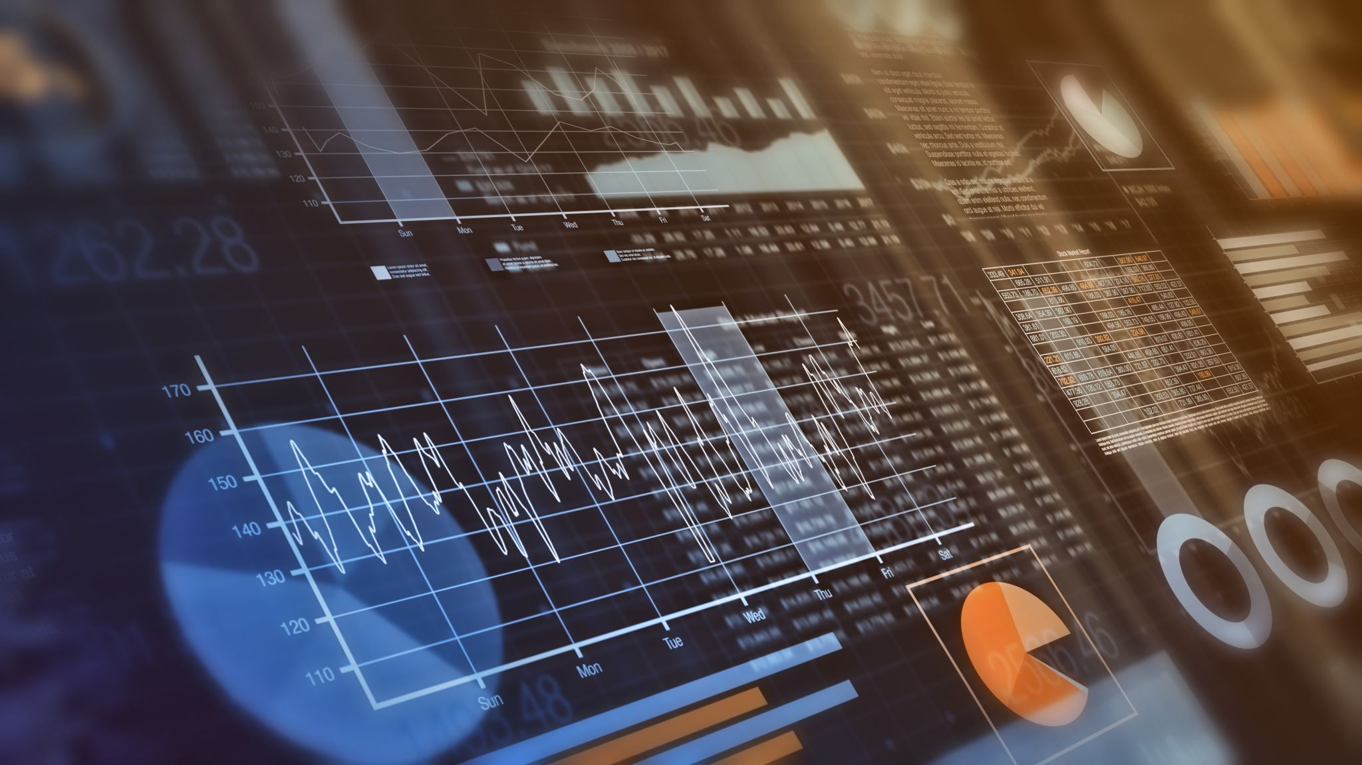
Technologies used in making of the project
Windows 11 operating system in harddisk fixed to system unit(Bill Gates & Paul Allen on 4/4/1975 started this graphic user interface faster than CUI where no need to remember any commands just interact by mouse click on icons/pictures representing collection of programs,tools & resources with multitasking,peek(show desktop),jump list(rrecent files),device stage(manages connected cell phones,printer & cameras),math input(write math exprssn) & Handwriting recognition features with faster n more responsive performance,easy device management & improved taskbar also full screen preview with access to internet)
Web browser is a software used to connect & work with internet accessing webpages,sending response & receiving request information through web server stored in computer,web is collection of info on net where each page is called webpage & its large related collection is website with unique address of resource as uniform resource locator & World wide web is collection of information stored on computers around the world whose new content is alerted by web feeds using(RSS) with computer identified by letter addressing system/domain naming system,where domain provides type of organisation website belongs to. Wide Area Network/internet collectively owned connects several countries(world)using transmission control/internet protocol/rule
930GB harddisk are collection of disk called platters coated with material magnetic data recording with large space(40GB-TB’s)
4GB Random Access Memory is primary memory unlike above secondary memory randomly,directly accessed by CPU to read or store/ write info on it,currently being worked on is temporary & volatile memory(erased when power off) size range from 512MB to few GB’s divided into static:stores data till power on & dynamic ram which loses data in short durations even if power’s on
Compiler translates high level to machine language at one go showing errors,same done line-by-line execution by slow interpreter.
Java,high level language started by james gosling at sun microsystems in 1995 with simple learn,object(instance of class having state & behaviours)oriented programming,case sensitive,multitasking(threads),secure by authentication by encryption to virus & tamper free environment,robust as it remove error-prone situation by compile time & runtime error checking, portable (implementation independent) & platform/operating system independent,compiles on one & runs on other computer,with primitive datatypes:int(number),char(alphabet),Boolean(true or false),float(single precision floating point number) & non-primitive reference type(objects & array).Structured query language helps in querying data,controlling database access,guarantee database integrity & consistency,create replace altering & dropping database & inserting deleting & updating records with portability,high speed,simple to learn,relational database,client/server base,object oriented,act as programming & interactive language
Notes:
RSS-really simple syndication program read by computer to suggest as subscribed websites
Sun microsystem slogan-Write Once Run Anywhere

Slide 16

Functions used in the program n workflow
Static-java calling method without instance of class,Void-main method executes & terminates without returning values
HTML (index.html):
<form>, <input>, <textarea>, <select>, <button>:
Purpose: Create interactive forms for user input (login, file upload, etc.).
<div> and <span>:
Purpose: Structure and group HTML content for layout and dynamic display.
<a>:
Purpose: Create hyperlinks for navigation.
<header>, <main>, <section>, <nav>:
Purpose: Provide semantic structure to the webpage layout.
enctype="multipart/form-data":
Purpose: Enable file uploads in forms.
accept=".py":
Purpose: Restrict file selection to Python files.
JavaScript:
document.getElementById():
Purpose: Retrieve HTML elements by their ID.
addEventListener():
Purpose: Attach event listeners for user interactions.
fetch():
Purpose: Send HTTP requests to the backend.
FormData.append():
Purpose: Construct form data for submission.
response.json():
Purpose: Parse JSON responses from the backend.
event.preventDefault():
Purpose: Prevent the default action of an event.
document.querySelectorAll():
Purpose: Retrieve all HTML elements that match a CSS selector.
element.closest():
Purpose: Find the closest ancestor element that matches a selector.
element.style.display:
Purpose: Show or hide HTML elements.
console.log():
Purpose: Output messages to the browser's console.
alert():
Purpose: Display alert messages to the user.
MySQL Database:
CREATE DATABASE:
Purpose: Create a new database.
USE database_name:
Purpose: Select a database for use.
CREATE TABLE:
Purpose: Create new database tables.
INT, VARCHAR, DECIMAL, BOOLEAN:
Purpose: Define data types for table columns.
AUTO_INCREMENT, PRIMARY KEY, UNIQUE, NOT NULL, DEFAULT, FOREIGN KEY:
Purpose: Define constraints on table columns.
INSERT INTO:
Purpose: Insert data into tables.
SELECT:
Purpose: Retrieve data from tables.
UPDATE:
Purpose: modify data in tables.
Java (JDBC):
java.sql.Connection:
Purpose: Represent a database connection.
java.sql.PreparedStatement:
Purpose: Represent precompiled SQL statements.
java.sql.ResultSet:
Purpose: Represent database query results.
java.sql.SQLException:
Purpose: Handle database errors.
General Java Concepts:
try-catch:
Purpose: Handle exceptions.
Map<String, Object>:
Purpose: Store key-value pairs.
InputStream and OutputStream:
Purpose: Handle file I/O.
Path and Files:
Purpose: Handle file system operations
Java Backend (BiocodeBackend.java):
Spark.port():
Purpose: Set the port for the Spark web server.
Spark.post() and Spark.get():
Purpose: Define HTTP routes for handling requests.
request.queryParams():
Purpose: Retrieve query parameters from HTTP requests.
response.type():
Purpose: Set the response content type.
DriverManager.getConnection():
Purpose: Establish a database connection.
PreparedStatement.executeQuery() and PreparedStatement.executeUpdate():
Purpose: Execute SQL queries.
ResultSet.next():
Purpose: Iterate through database query results.
Gson.toJson():
Purpose: Serialize Java objects to JSON.
request.raw().getPart().getInputStream():
Purpose: Get the input stream of uploaded files.
Files.copy():
Purpose: Save uploaded files to the server.
Integer.parseInt() and Double.parseDouble():
Purpose: parse string to integer and double.
Random.nextInt():
Purpose: generate a random integer.
Statement.RETURN_GENERATED_KEYS:
Purpose: returns the generated keys from a database insert.
ResultSet.getGeneratedKeys():
Purpose: retrieves the generated keys from a database insert.

Slide 17

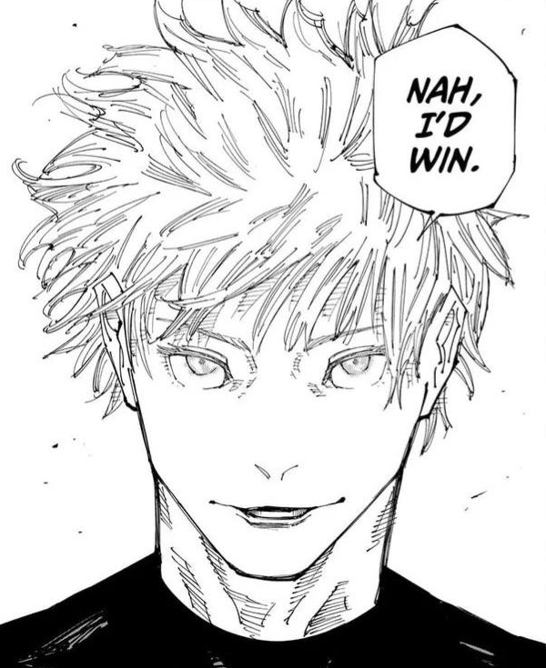
Current limitations
Highly simplistic website(unattractive)
Inspiration & uniqueness checking from our database
No password protection
Only python files accepted(branding for bioinformaticians for now)
no robust feedback system
Payment accepted by upi through contact
Informational not legal patent for time being
Challenges in future
Logistics & Scalability-taking feedback
Getting rights for ncbi & ebi database usage
Security threats-encryption & password hashing
Tying up with various patenting organisations
Hiring professionals or making ai models & getting data to train it
Customer acquisition & retention due to niche-we can run campaigns around science shows
Search engine optimization-using relevant tags
making profits with reasonable pricing-taking bulk demands
Convincing hackathon to let us work with them
Flexibility in file handling-remove .py extension restriction
maintaining transparency-open sourcing
Arranging feedback mechanism & customer care system
Managing large databases with better performance-aggressive testing with phased deployment(alpha,beta tests)

Slide 18


Our features n usecase
This should reduce backdoor shady businesses,standardize & centralize patenting at comfort of your home
This should make processes smooth & efficient by giving options from storing to selling at one place
This can make the process less scry n fun & reduced entry barrier
Since we’d have bulk no. of patents,they’d need to negotiate,assistance in buying rights for businesses
Free for you to sell,certify with delivery of certificate with minimal fee,gain trust in hackathons
You can securely store your code to claim it & we’d have a huge database of projects,kept in records
Mechanism n machinery-
• Html as frontend interacts with you guys n make patenting less scary to you.
• java as backend performs operations,gives commands connecting html & SQL uses JDBC & spark.
• finally MySQL as database stores your data,search for specific data,compares data & retrieves data to me to proceed with your patent filing.
• Login page gets information about you,contact medium & your project
• Then we have 5 options for you to select from:
1. Sell-we will mediate between you n businesses to sell your invention at best price with respecting your full rights to stepback anytime, free for you but take our small fee from businesses.
2. Store-stores your inventions with us so no one copies your project but rights still fully not yours but kept to decide later what to do with it.
3. Check uniqueness-Our database search within itself if your project matches in it then tell you if you need to work more or if it’s eligible for patenting(for now cant search larger databases like ncbi due to our technology limitations).
4. Certify and patent-We’d love to assist you with your patenting journey being your painbearer with a minimal fee.we’ll do paperwork as per your directions contacting you n using your given details and deliver your patent certificate at your home.
5. Inspire-we’d find related topics or unfinished topics from our database to give you a HeadStart to get patent for improvment.
Thank you for your time to check this out

Slide 19

Future scope
In future,this website can use larger databases like ncbi & ebi
We can merge with hackathons to check & certify all participants product
We can help government make process smoother and experiences inteactive
We can expand into other domains of science(now I’m only concerned about niche bioinformaticians,so only accept .py files) by accepting wide variety of files.
We can make a dashboard so, you can manage & monitor it all in one place and your stuff stays organized & transparent and sort of gamified
We can combine services of more n more countries patents n certification
Ai may generate inspiration rather than finding from database of incomplete researches or even may fill the form for you with your minimal details
We can make it more fun by adding css n js animations n designs
We can improve it SEO’s n market it for awareness
We may need to hire professional lawyers n bioinformaticians to verify projects n do the right things while applying
We can add payment gateways rather than contacting & taking payments in upi
Can try to give all updates for free
We can charge small fee to clients for certifying & fee for businesses n free when selling rights while mediating
We can put password protection in it to enhance protection
We can give better anonymity by asking address after they either choose to certify or sell just for authentication after improving our customer retention n collecting a large data on our servers for improvement & add encryption
We can later provide them 24/7 contact with professional or ai if they have doubt to fill forms
We can promote ourselves keeping competition in schools

Slide 20


bibliography
Cambridge social sciences by Devyani kapoor
Trueman’s biology by K.N. Bhatia
Click start computer computer science Cambridge by n meera
Exploring information technology macmilan by rohit khurana
Dbms using sql by arihant
oOp java by techknowledge
Boot-click enter macmilan by Gurpreet bindra
Fast forward oxford by sangeeta Panchal
Terabytes connect with computers Cambridge by Vaishali sharma
KIPS information technology vocational
BEGS-186 Business communication by dr. anand Prakash
Bcos-185 entrepreneurship prof. Madhu tyagi

Slide 21
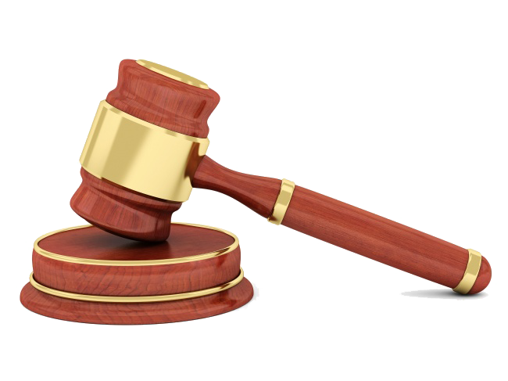

Lets not lose another basmati rice due to less accessible patenting
Thank You!
This Photo by Unknown Author is licensed under CC BY-SA

